Slide 1
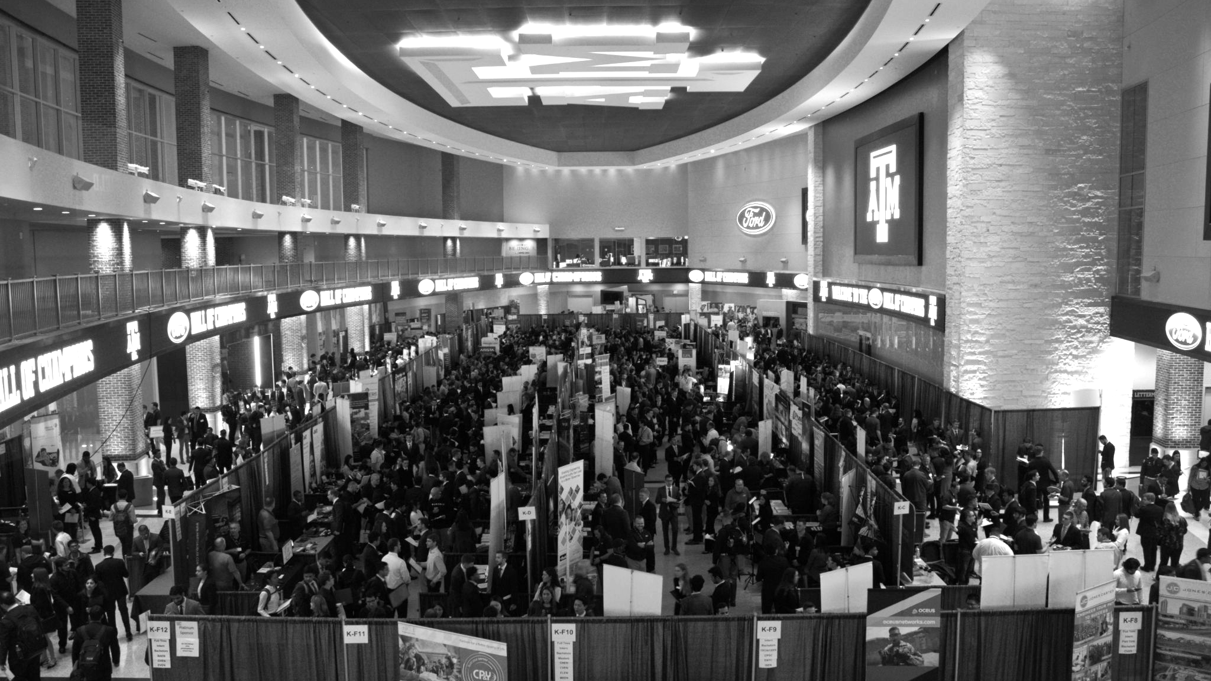

LANL Team Project Update
3/5/2025
Izzy Baumler, Dalton Boeckmann, Morgan Gullo, Jade Waldron

Slide 2
Problem Statement/Project Motivation
There is a need for a technology that has 5 DOF and can move through its full range of motion in each degree of freedom of at least 1 Hz.

Slide 3
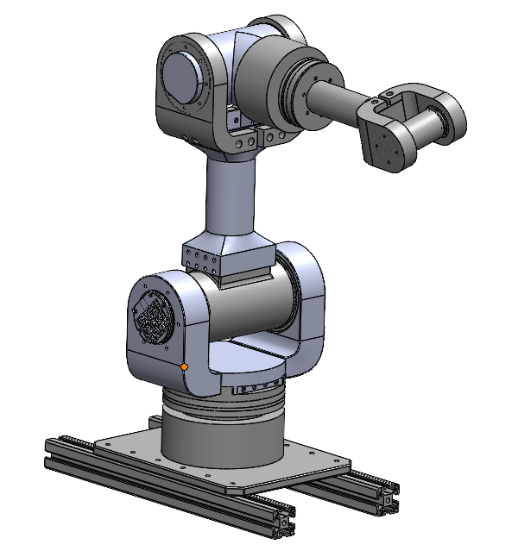
Weekly Assigned Tasks
Jade - Solidworks Refinement/Prototyping/Assembly
Izzy - Motor Research and testing
Dalton - Assembly/Motor Testing
Morgan - Purchase Orders/Electrical

Slide 4
Sponsor Update
Provided insight into utilizing serial and CAN to control motors
Provided robotics examples that are controlled utilising python library
Mevius
With time constraints wants the team to pursue utilizing R-link to control the motors

Slide 5
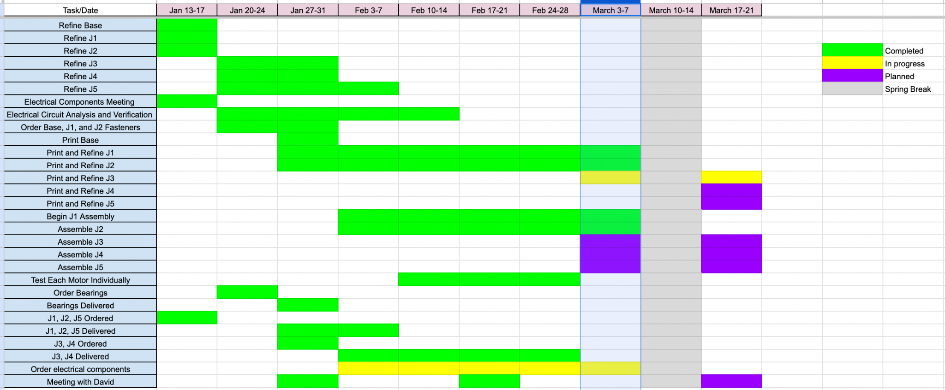
Schedule Update

Slide 6
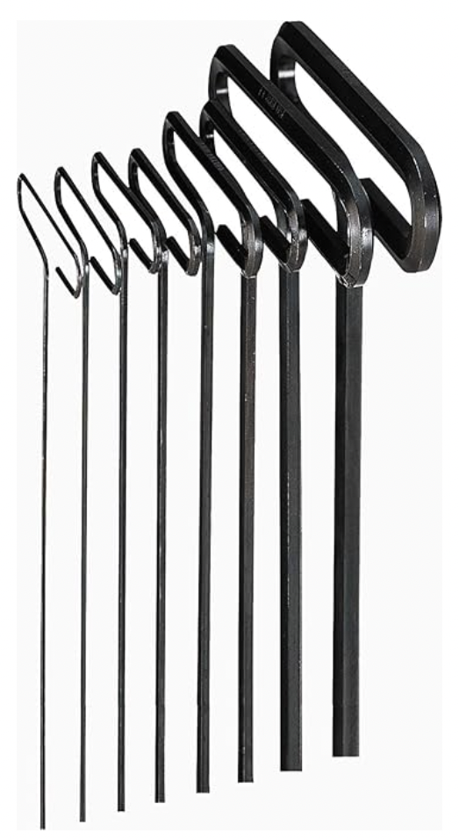
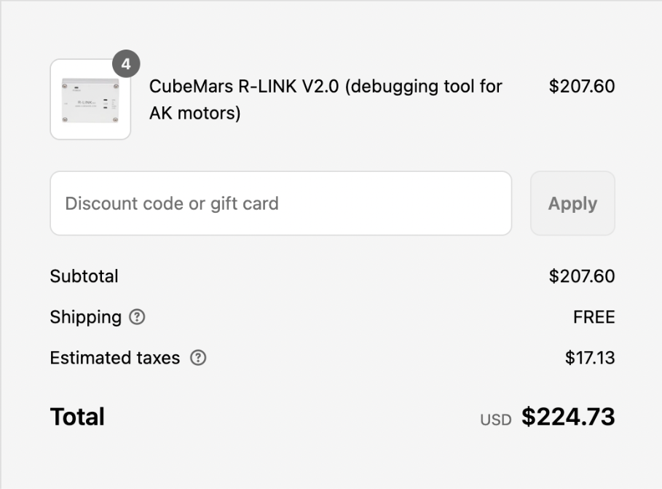
Orders Update

Slide 7
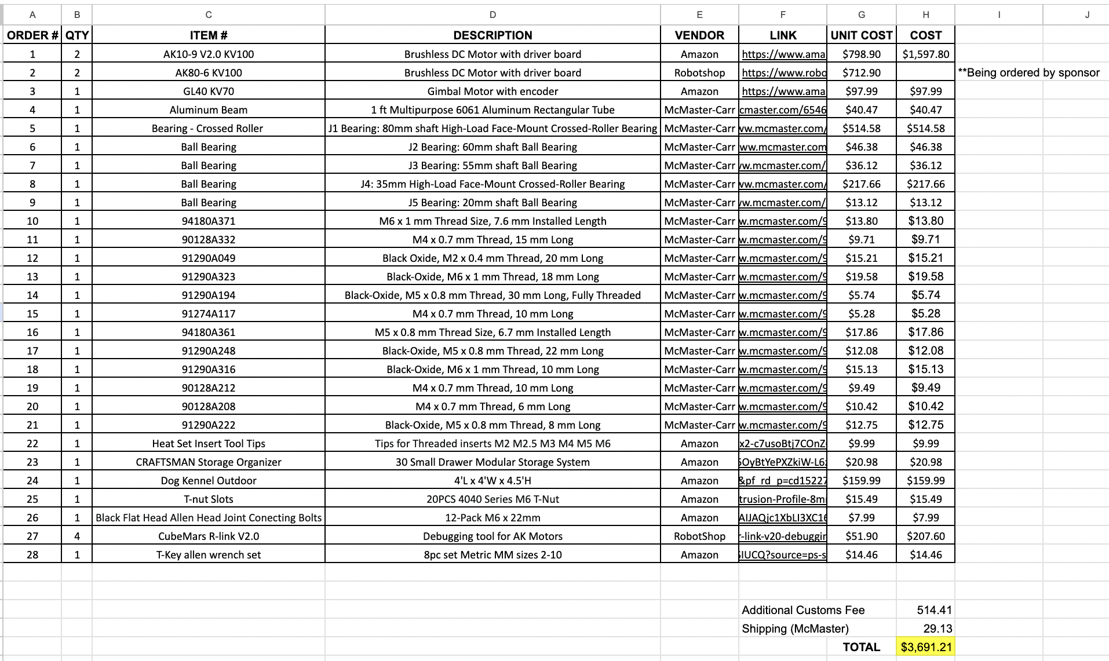
Budget Update

Slide 8
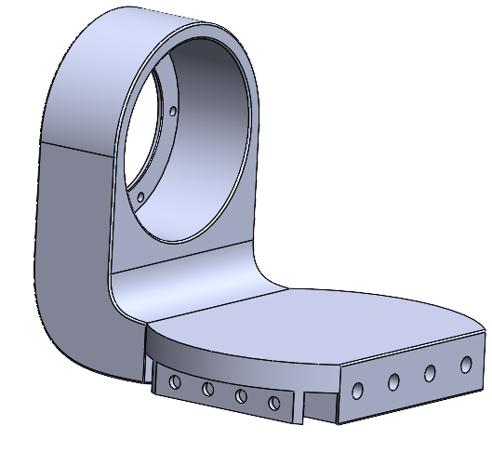
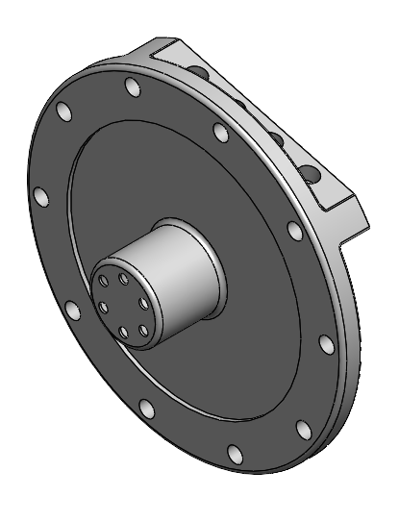
Solidworks Refinement

Slide 9
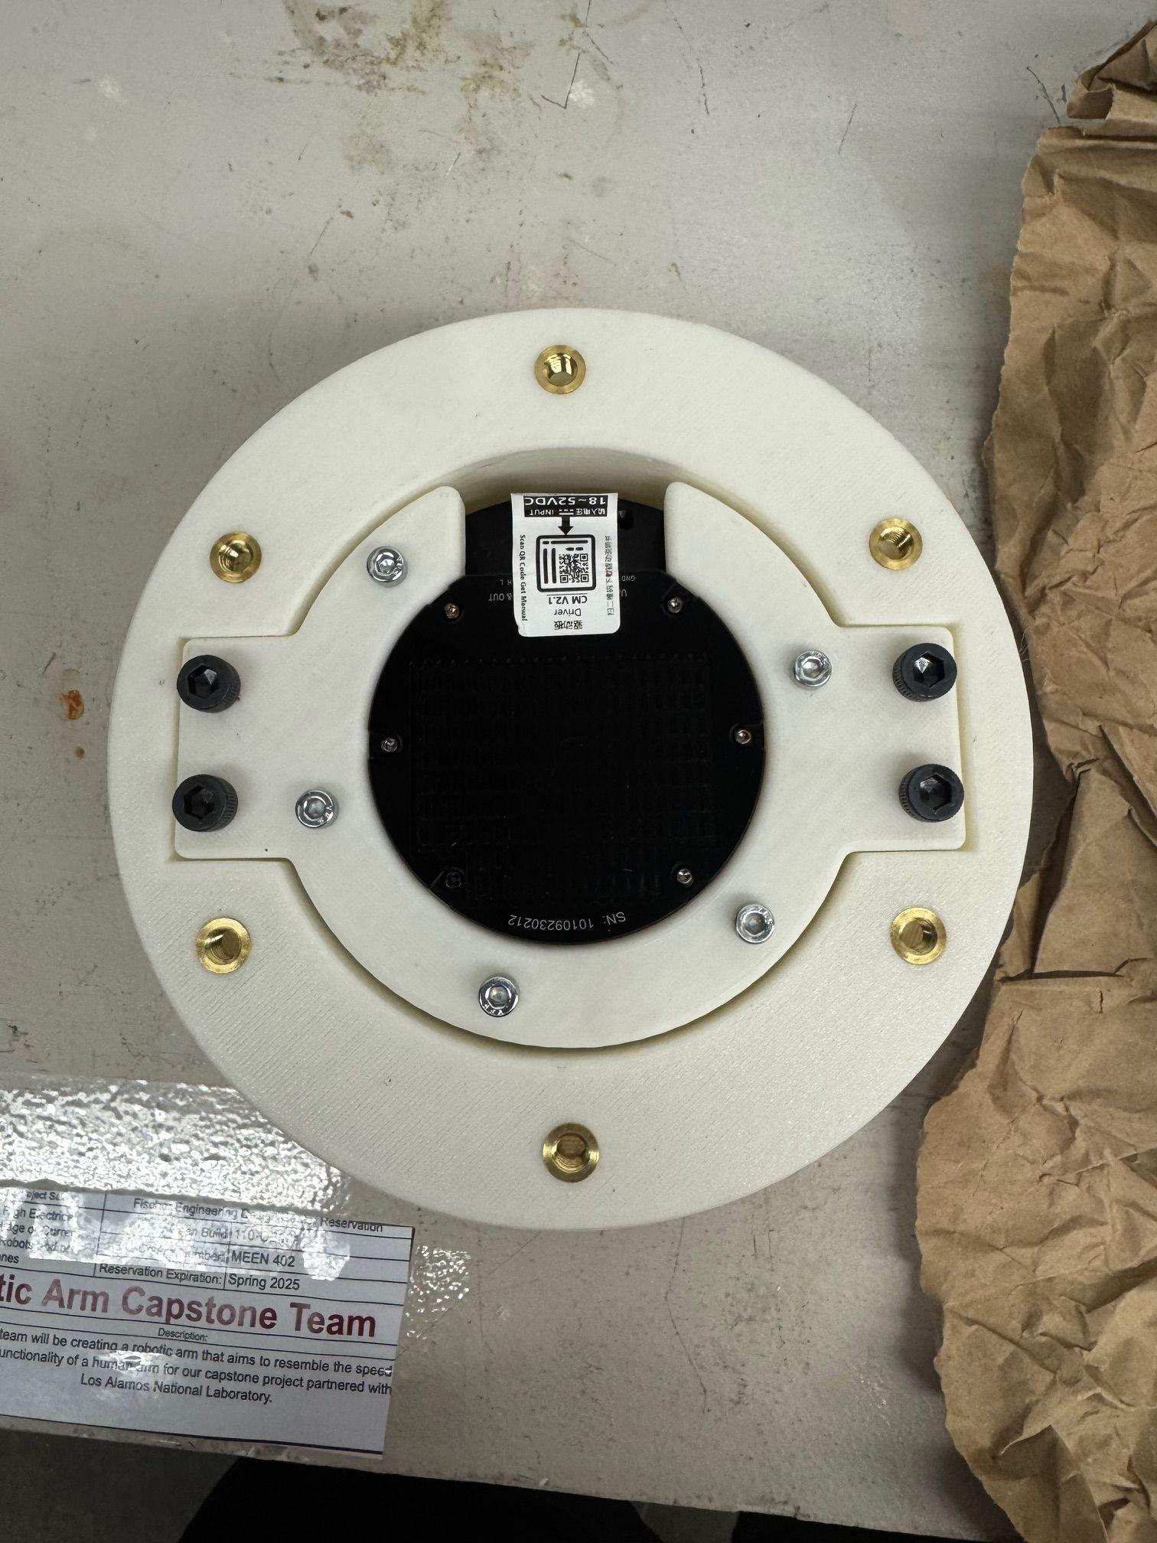
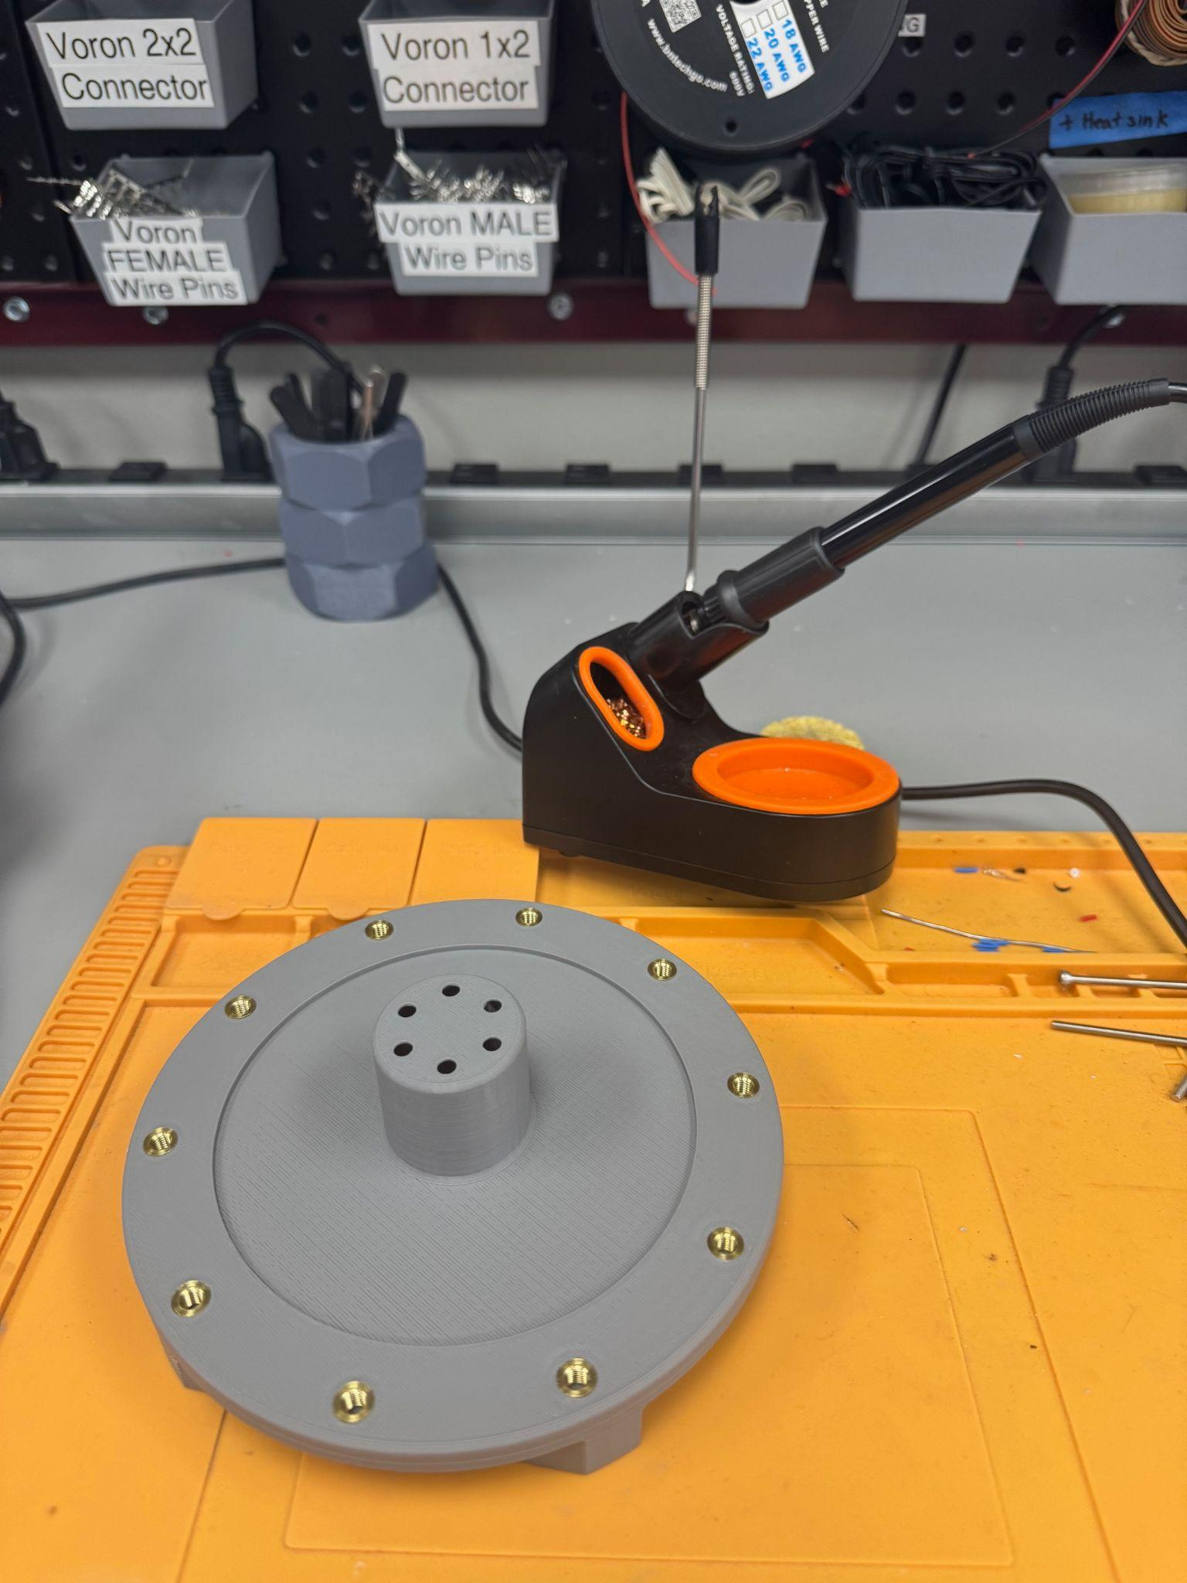
Soldering
Soldered ~30 heat set inserts on various parts (J1,J2)

Slide 10
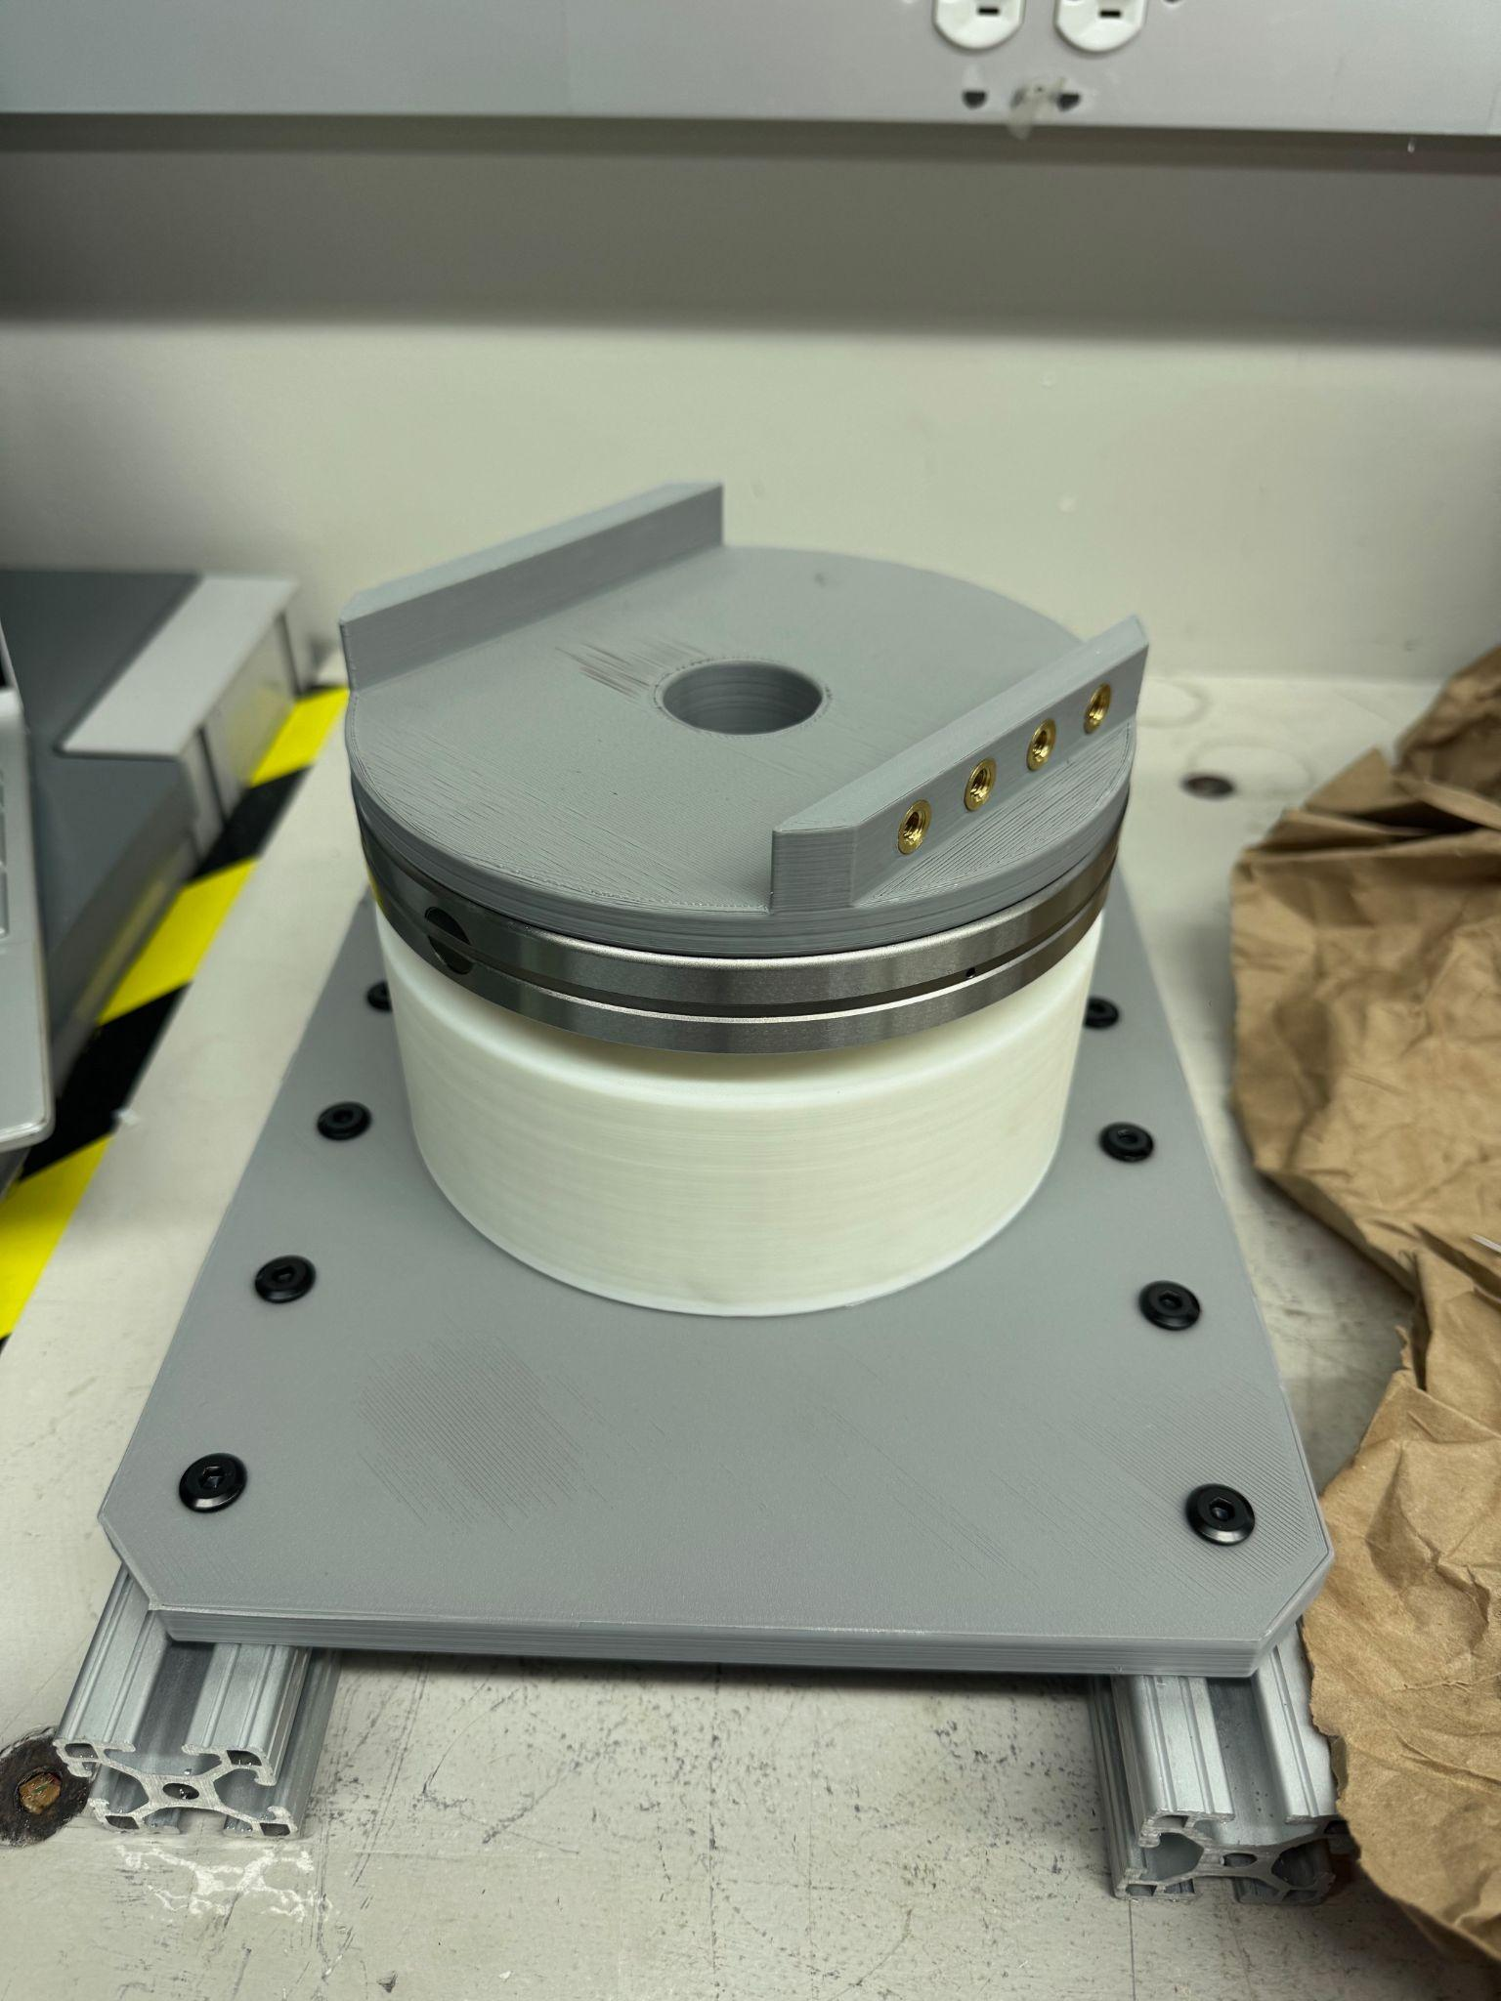
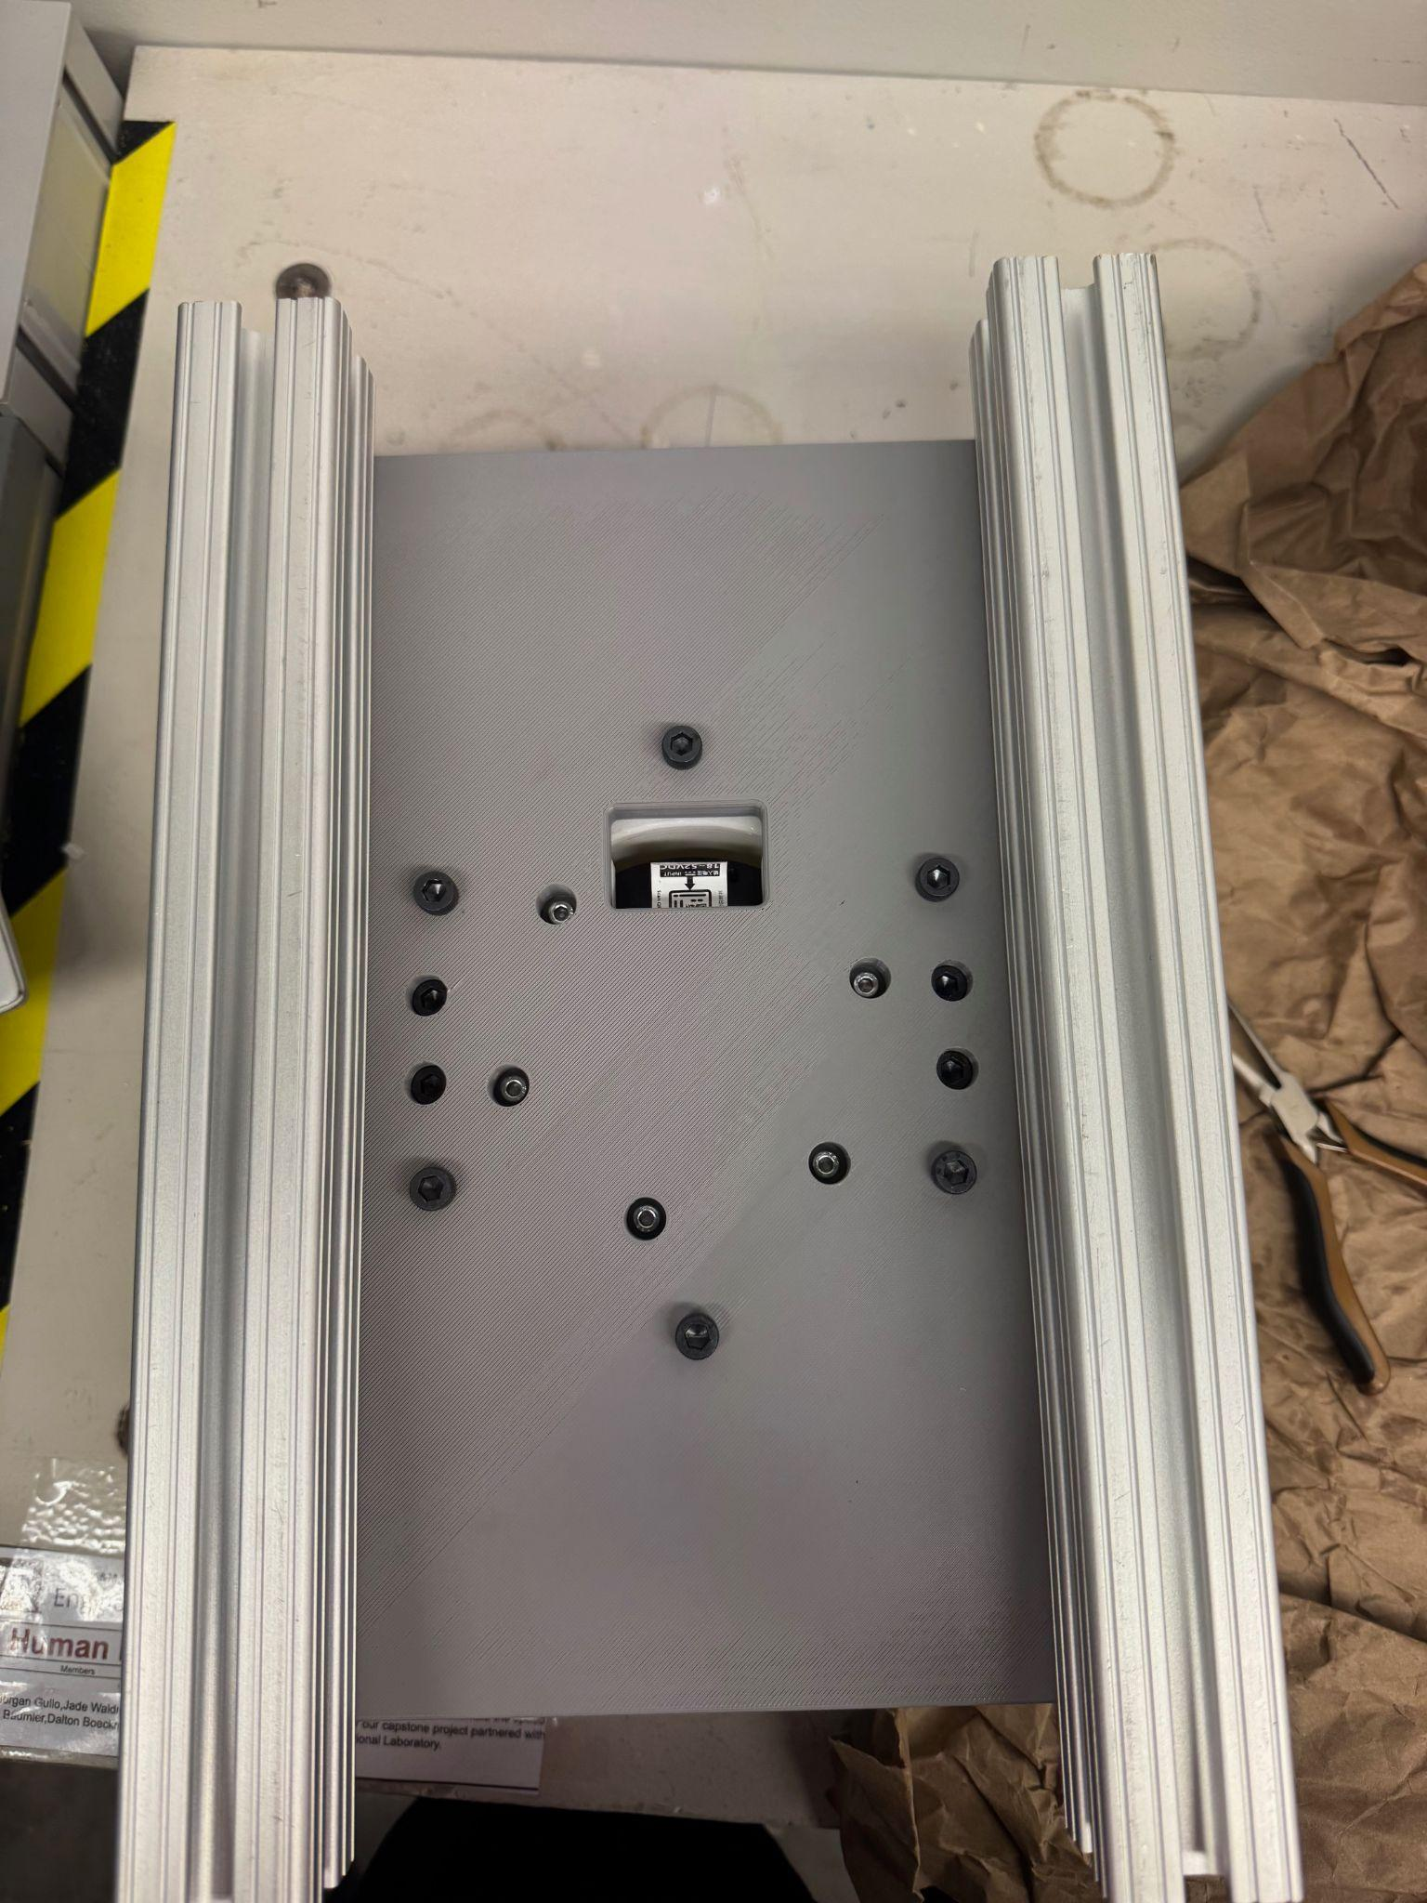
Prototyping/Assembly
J1 interface to J1 motor thinner than expected, will send to reprint mushroom cap
J1 and Base interface has no other issues
Assembly manual will be updated to reflect current assembly process

Slide 11
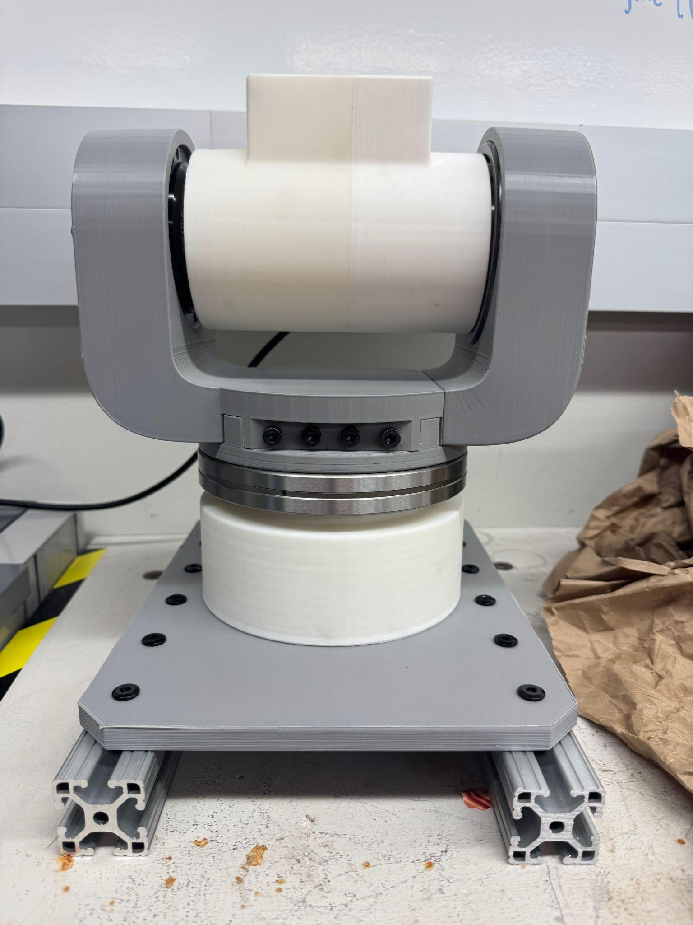
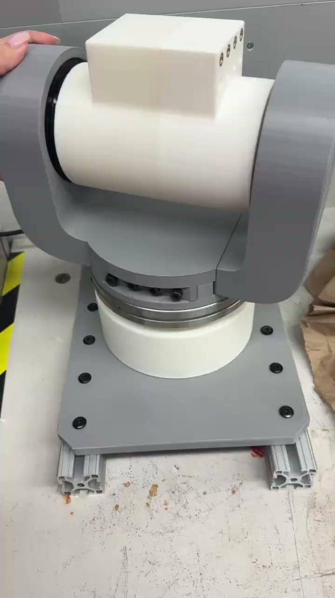
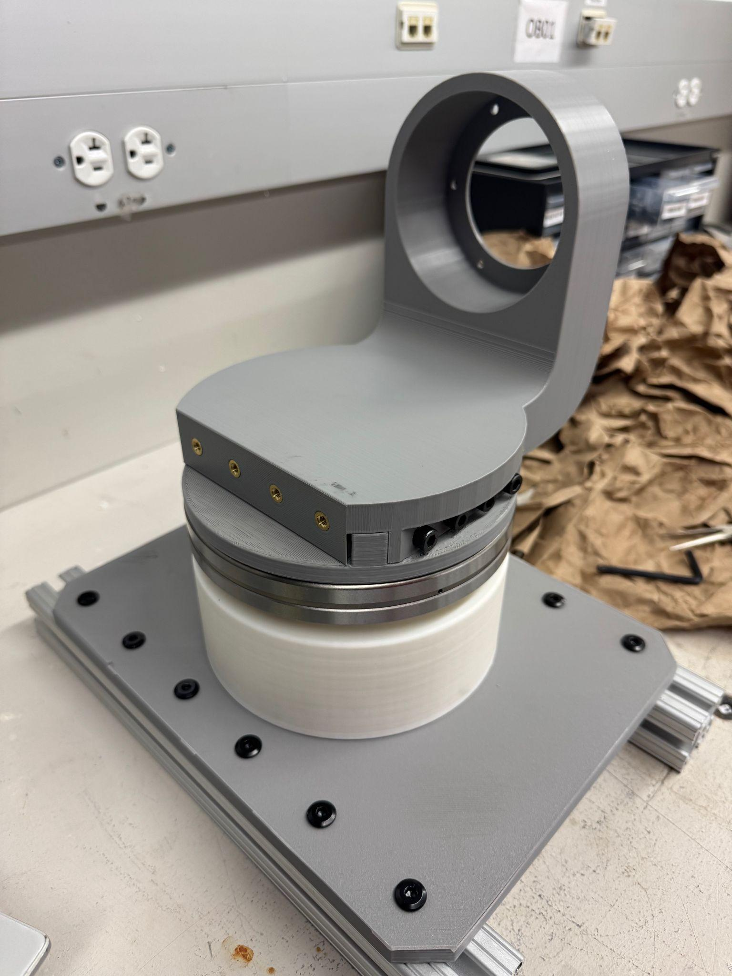
Prototyping/Assembly

Slide 12
Future Work
Order/Verify electrical components
Print Bicep and J3
Continue Assembly Manual changes and updates
Motor testing for J3/J4/J5

